Slide 1
Portland Trail Blazers
Conjoint Analysis
Group 8
Emely Callejas, Ashley Cortez,
Rithvik V Sourab, Angelica Verduzco

Slide 2

Case Background & Problem
Following the 2005 NBA All-Star Break, the Portland Trail Blazers encountered major challenges. They experienced the dismissal of their coach, and were on track to have one of their worst seasons. Additionally, their home arena, the Rose Garden, had recently filed for bankruptcy. Attendance levels dropped by over 15% since 2003, and television views were declining rapidly.
To address these challenges, the Portland Trail Blazers decided to get assistance from a marketing research firm to conduct a conjoint analysis focusing on their season packages. The primary goal is to enhance the appeal of their packages while maintaining profitability. To achieve this, 960 fans who had previously purchased tickets were surveyed

Slide 3
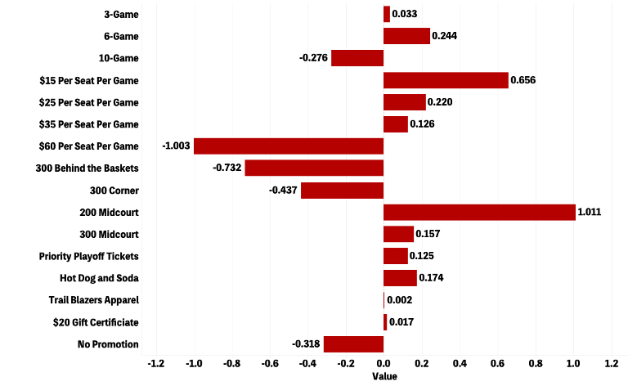
Attribute Part-Worths (Utility)
From the initial data provided, we can see the utility of each attribute level.
At a first glance, we can observe the following:
Number of Games:
10-Game packages have the least utility.
Ticket Price:
$15 Per Seat Per Game has the most utility, while $60 Per Seat Per Game had the least
Ticket Location:
300 Corner had the least utility and 200 Midcourt had the most.
Promotional Item:
Promotional Items have minimal utility. Within the options, ‘Hot Dog and Soda’ had the most utility and ‘No Promotion’ had the least

Slide 4
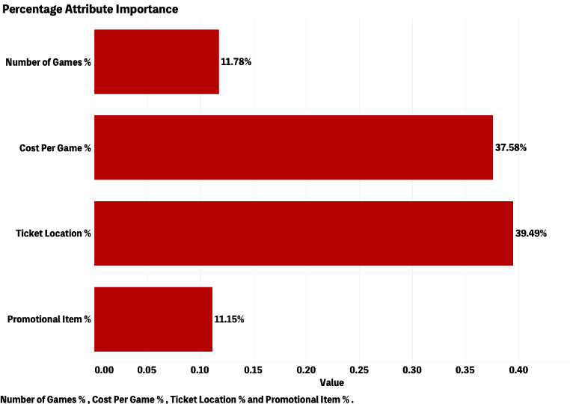
Percentage Attribute Importance
By Category
Ticket Location represents nearly 40% of the shift in utility, with Cost Per Game following closely behind with 38% importance.
Of the 204 responses, these attributes were significantly more important than the Number of Games and Promotional Items included in the multi-game packages.
There were also details for opposing teams and day of game, however these were not considered in the original conjoint analysis since the combination of details was already predetermined.

Slide 5
Selecting A Base Case
Blazers management is unwilling to allow the following price and seating combinations due to the cost structure of the arena:
200-level seats for less than $60
300-level midcourt seats for less than $25
With these details and the part-worths for the attribute levels, we decided that the following combination would be the best-case scenario to select as our base case:
Number of Games: 10-Game Package
Cost Per Game: $60 Per Game
Ticket Location: 300 Behind Baskets
Promotional Item: No Promotion
Rationale: We chose these attribute levels as the baselines for our base case because they each had the lowest utility score within their respective attribute category. Meaning that the survey respondents indicated that these attribute levels had the lowest ranking or least importance when compared to the other levels.

Slide 6
Willingness to Pay
Number of Games | Utility Score | WTP
3 - Game | 0.0327 | $0.88
6 - Game | 0.24383 | $6.61
10 - Game | 0 | 0
Ticket Price
$15 per seat per game | 0.65654 | $17.81
$25 per seat per game | 0.22011 | $5.97
$35 per seat per game | 0.126 | $3.42
$60 per seat per game | 0 | 0
Ticket Location
300 Behind the Basket | 0 | 0
300 Corner | -0.43716 | -$11.86
300 Midcourt | 0.15736 | $4.27
200 Midcourt | 1.01148 | $27.44
Promotional Item
Priority Playoff | 0.12511 | $3.39
Hot Dog and Soda | 0.17428 | $4.73
Trail Blazers Apparel | 0.00158 | $0.04
$20 Gift Certificate | 0.01689 | $0.46
No Promotion | 0 | 0
Dollar Utility | $27.12
Dollar Utility = $27.12
Dollar Utility = -45 / (-1.00257 - 0.65646)
Highest Willingness to Pay Attributes
Number of Games
6 - Game = $6.61
Ticket Price
$15 per seat per game = $17.81
Ticket Location
200 Midcourt = $27.44
Promotional Item
Hot Dog and Soda = $4.73

Slide 7
Should the Trail Blazers Raise/Lower Prices?
Dollar Utility = $27.12
Based on the given ticket location and cost per game combinations, the Portland Trail Blazers should reconsider the pricing of certain ticket combinations.
There is opportunity to raise and lower prices for the following combinations:
Raise prices for combinations A and D
People have a WTP higher than the cost of the ticket for Combination A.
People have a high utility for 200 Level Midcourt seats. With the baseline level at $60, Combination D has the highest WTP.
Lower prices for combination B
300 Corner seats are the furthest and may have an obstructed view, so people are less willing to pay higher prices for these seats.
 | Ticket Location Utility | Cost Per Game Utility | WTP
A | 300 Level Behind the Baskets* | $15 Per Ticket | $17.81
 | 0.00 | 0.65646
B | 300 Level On the Corners | $25 Per Ticket | -$5.89
 | -0.43716 | 0.22011
C | 300 Level Midcourt | $35 Per Ticket | $7.69
 | 0.15736 | 0.126
D | 200 Level Midcourt | $60 Per Ticket* | $27.44
 | 1.01148 | 0.00
* This attribute level is part of the base case, so the utility is set to zero

Slide 8
Promotional Items WTP
Dollar Utility = $27.12
Which promotional items are worth providing in ticket packages?
Can justify higher charge for Hot Dog & Soda
Including this promotional item costs the team $3.25 per package.
People are willing to pay more for this promotional item in comparison to what it costs the Trailblazers to provide it.
Can justify higher charge for Priority Playoff Tickets
There is no direct cost to the team for offering this promotional item.
People are willing to pay more to have priority access to playoff tickets.
Trail Blazers Apparel and $20 Gift Certificate may not be worth the cost to include as a promotional item.
Including the apparel costs the team $12 per package.
Including the gift certificate costs the team $10 per package.
WTP for this item is not enough to justify the cost.
Promotional Item | Utility | WTP
Priority Playoff Tickets | 0.12511 | $3.39
Hot Dog and Soda | 0.17428 | $4.73
Trail Blazers Apparel | 0.00158 | $0.04
$20 Gift Certificate | 0.01689 | $0.46
No Promotion* | 0.00 | $0.00
* This attribute level is part of the base case, so the utility is set to zero

Slide 9
Promotional Items WTP (continued)
Dollar Utility = $27.12
Why are certain promotional items seen as more/less valuable by the respondents?
One thing to remember is that the survey respondents were fans of the Blazers and people who had previously purchased multi-game packages.
Considering the above note, Trail Blazers Apparel might not have a higher utility/WTP because the respondents are fans that may already have apparel.
The $20 Gift Certificate to a restaurant may have a lower WTP because fans might find more value in having a meal at each game in their package (Hot Dog and Soda) than a one-time gift certificate to a restaurant that is not of their choosing.
Promotional Item | Utility | WTP
Priority Playoff Tickets | 0.12511 | $3.39
Hot Dog and Soda | 0.17428 | $4.73
Trail Blazers Apparel | 0.00158 | $0.04
$20 Gift Certificate | 0.01689 | $0.46
No Promotion* | 0.00 | $0.00
* This attribute level is part of the base case, so the utility is set to zero

Slide 10
Market Research Recommendations
The Portland Trail Blazers can research more promotional items such as alcoholic beverages for 21+ fans being included in the promotional items since the hot dog and a drink had the highest WTP amongst the promotional item
Since multigame purchasers had priority for purchasing games, it would informational to delve into the demographics of those buyers to better target marketing strategies
A customer segmentation analysis would give a deeper analysis of market segments to tailor marketing strategies effectively. Identify fan priorities on affordability, the live game experience, or promotional items.

Slide 11
Summary
We can conclude and summarize that the most important attributes affecting the attractiveness of ticket packages are the Ticket Location costing nearly 40% of the shift and the Cost per Game with 38% importance. We find that the Portland Trail Blazers should consider raising prices for 300 level Behind the Baskets and 200 level Midcourt seats due to high WTP and should lower prices for 300 level on the corners due to a lower WTP.
We can tell that the promotional items worth providing in the ticket packages are ‘Hot Dog and Soda’ and the ‘Priority Playoff Tickets from their WTPs.
Some research recommendations include promotional items such as alcoholic beverages for 21+ fans being included in the promotional items since the hot dog and a drink had the highest WTP amongst the promotional item, and a customer segmentation analysis which would give a deeper analysis of market segments to tailor marketing strategies effectively.

